Slide 1
SURFACE CHEMISTRY
CLASS :12

Slide 2
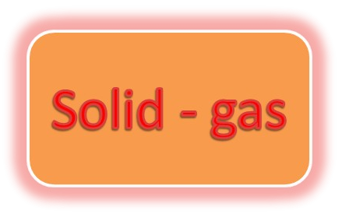

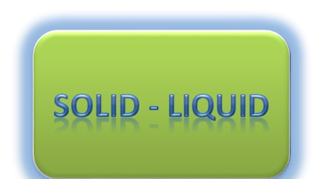
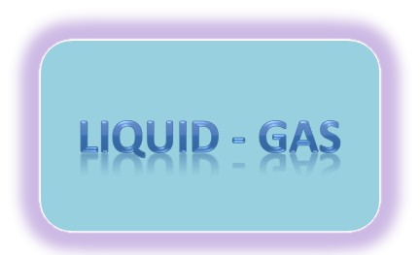
INTRODUCTION
Surface chemistry is the study of processes that occur at the interface of two bulk phases.
The bulk phases can be of the type :
Liquid - liquid

Slide 3
TYPES
ADSORPTION: is the adhesion
of atoms, ions, biomolecules or molecules of gas, liquid, or dissolved solids to a surface.
ABSORPTION: is a physical or chemical phenomenon or a process in
which atoms, molecules, or ions enter some bulk phase - gas, liquid, or solid material.

Slide 4
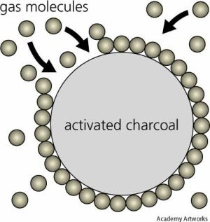
Adsorption on activated charcoal.

Slide 5
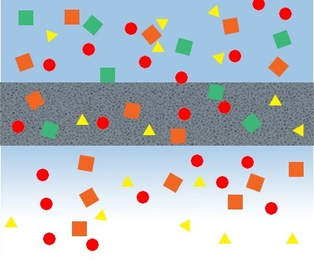
Absorption through a membrane

Slide 6

Adsorption
Adsorbate
Adsorbent
Absorption (“partitioning”)
PHASE I
PHASE 2

Slide 7
Adsorption
Adsorbate: material being adsorbed
Adsorbent: material doing the adsorbing
Physical adsorption: Van der Waals attraction between adsorbate and adsorbent. The attraction is not fixed to a specific site and the adsorbate is relatively free to move on the surface. This is relatively weak, reversible, adsorption capable of multilayer
Chemical adsorption: Some degree of chemical bonding between adsorbate and adsorbent characterized by strong attractiveness. Adsorbed molecules are not free to move on the surface. There is a high degree of specificity and typically a monolayer is formed. The process is seldom reversible.
ADSORPTION EQUILIBRIA: If the adsorbent and adsorbate are contacted long enough an equilibrium will be established between the amount of adsorbate adsorbed and the amount of adsorbate in solution. The equilibrium relationship is described by ISOTHERMS.
adsorption.

Slide 8
Causes of Adsorption
Dislike of Water Phase – ‘Hydrophobicity’
Attraction to the Sorbent Surface
  van der Waals forces: physical attraction
  electrostatic forces (surface charge interaction)
  chemical forces (e.g., π- and hydrogen bonding)

Slide 9
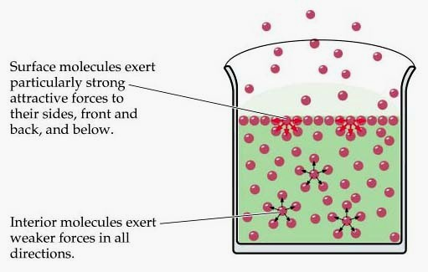

Slide 10
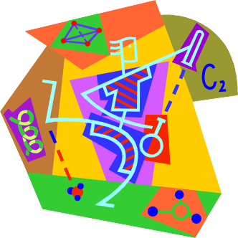
Types of Adsorption
Depending on the nature of attractive forces existing between the adsorbate and adsorbent,
adsorption can be classified as:
PPhhyyssicical Adsorptioion
CChemicalAAddssorptioion

Slide 11

Difference between
Physisorption Chemisorption
Forces of attraction are vander Waals’ forces
Low enthalpy of adsorption (20 - 40 k.J/mole)
This process is observed under conditions of low temperature
It is not specific
Multi-molecular layers may be formed
This process is reversible
Forces of attraction are chemical bond forces
High enthapy of adsorption (200 - 400 k.J/mole)
This process takes place at high temperatures
It is highly specific
Generally, monomolecular layer is formed
This process is irreversible

Slide 12
Physisorption is a general phenomenon and occurs in any solid/fluid or solid/gas system.
Chemisorptions is characterized by chemical specificity.
In physiorption, perturbation of the electronic states of adsorbent and adsorbate is minimal
For chemisorption, changes in the electronic states may be detectable by suitable physical means.
Typical binding energy of physisorption is about 10–100 meV.
Chemisorption usually forms bonding with energy of 1–10 eV.
The elementary step in physisorption from a gas phase does not involve an activation energy.
Chemisorption often involves an activation energy.
For physisorption, under appropriate conditions, gas phase molecules can form multilayer adsorption.
In chemisorption, molecules are adsorbed on the surface by valence bonds and only form monolayer adsorption.

Slide 13
ADSORPTION ISOTHERMS
Adsorption isotherm (also adsorption isotherm) describes the equilibrium of the sorption of a material at a surface (more general at a surface boundary) at constant temperature. It represents the amount of material bound at the surface (the sorbate) as a function of the material present in the gas phase and/or in the solution. Sorption isotherms are often used as empirical models, which do not make statements about the underlying mechanisms and measured variables. They are obtained from measured data by means
of regression analysis. The most frequently used isotherms are the linear isotherm, Freundlich isotherm, the Langmuir isotherm, and the BET model.

Slide 14
Freundlich Isotherm:
For the special case of heterogeneous surface energies (particularly good for mixed wastes) in which the energy term, “K_{F}”, varies as a function of surface
coverage we use the Freundlich model.
1
q_{e} = K_{F}C_{e} ^{n}
n and K_{F} are system specific constants.

Slide 15
Factors which affect adsorption extent (and therefore affect isotherm)
Solubility
In general, as solubility of solute increases the extent of adsorption decreases. This is known as the “Lundelius’ Rule”. Solute-solid surface binding competes with solute-solvent attraction as discussed earlier. Factors which affect solubility include molecular size (high MW- low solubility), ionization (solubility is minimum when compounds are uncharged), polarity (as polarity increases get higher solubility because water is a polar solvent).

Slide 16
pH
pH often affects the surface charge on the adsorbent
as well as the charge on the solute. Generally, for organic material as pH goes down adsorption goes up.
Temperature
Adsorption reactions are typically exothermic i.e., Δ H
_{rxn} is generally negative. Here heat is given off by the reaction therefore as T increases extent of adsorption decreases.

Slide 17
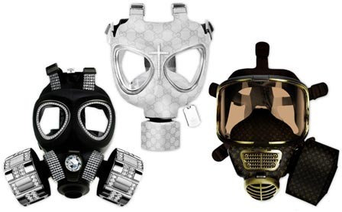
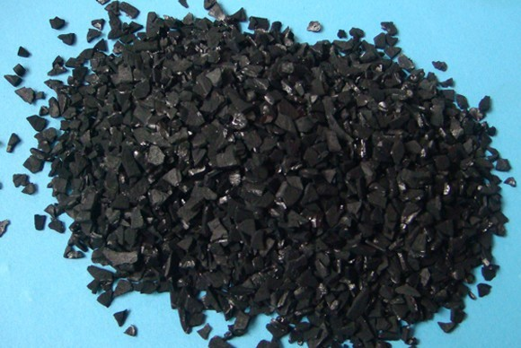
In gas masks:
All gas masks are devices containing suitable adsorbent so that the poisonous gases present in the atmosphere are preferentially adsorbed
and the air for breathing is purified.
In clarification of sugar: Sugar is decolorized by treating sugar solution with charcoal powder. The latter adsorbs the undesirable colors present.

Slide 18
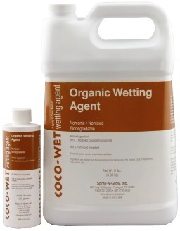
In paint industry:
The paint should not contain dissolved gases as otherwise the paint does not adhere well to the surface to be painted and thus will have a poor covering power. The dissolved gases are therefore, removed by suitable adsorbents during manufacture. Further, all surfaces are covered with layers of gaseous, liquid or solid films.
These have to be removed before the paint is applied. This is done by suitable liquids which adsorbs these films.
Such liquids are called wetting agents. The use of spirit as wetting agent in furniture painting is well known.

Slide 19
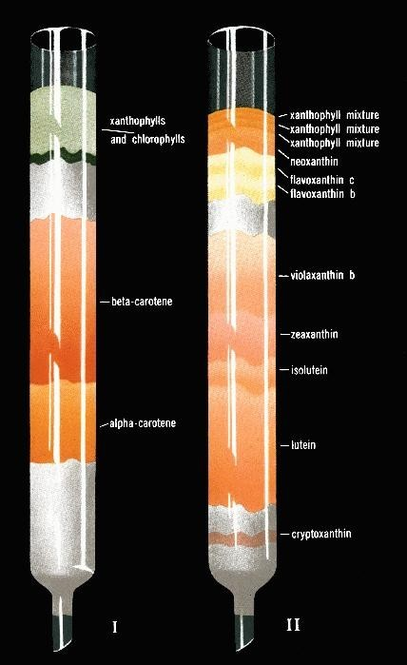
In chromatographic analysis: The selective adsorbent of certain substances from a solution by a particular solid adsorbent has helped to develop technique for the separation of the components of the mixture. This technique is called chromatographic analysis. For example: in column chromatography a long and wide vertical tube is filled with a suitable adsorbent and the solution of the mixture poured from the top and then collected one by one from the bottom.

Slide 20
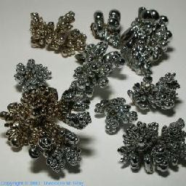
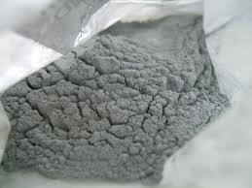
In catalysis:
The action of certain solids as catalysts is best explained in terms of adsorption. The theory is called adsorption theory. According to this theory, the gaseous reactants are adsorbed on the surface of the solid catalyst. As a result, the concentration of the reactants increases on the surface and hence the rate of reaction increases. The theory is also able to explain the greater efficiency of the catalyst in the finely divided state(Nickel in picture), the action of catalyst promoters

Slide 21
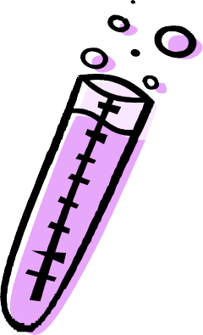
Properties of catalysts
The activity of a catalyst depends on the strength of chemisorption.
To be active, the surface of the catalyst should be extensively covered by the adsorbate, that is, the chemisorption should be strong.
However, if the strength of the adsorbent-adsorbate bond becomes too
strong then the activity of the catalyst declines because other reactant molecules cannot react with the adsorbate or because the adsorbate molecules become immobilized on the surface.
It has been observed that the catalytic activity increases from group 5 metals to group 11 with maximum activity shown by group 7-9 elements of the periodic table.

Slide 22
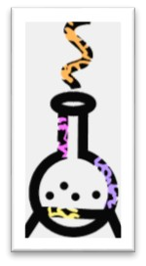
ENZYME CATALYSIS
Enzymes are macromolecules, usually proteins, produced in living systems, which act as catalysts in physiological reactions. The striking characteristics of enzymes are their catalytic power and specificity.
Enzymes have immense catalytic power; they accelerate reactions by factors of at least a million.
Most reactions in living systems do not occur at perceptible rates in the absence of enzymes.
A simple reaction like hydration of CO₂ is catalyzed by the
enzyme carbonic anhydrase.

Slide 23

The transfer of CO₂ from tissues into the blood and then to the alveolar air would be very slow in the absence of this enzyme.
The enzyme can hydrate 10⁵ molecules of CO₂ per second, which is 10⁷ times faster than the unanalyzed one.

Slide 24
Factors Affecting Enzyme Activity

Slide 25
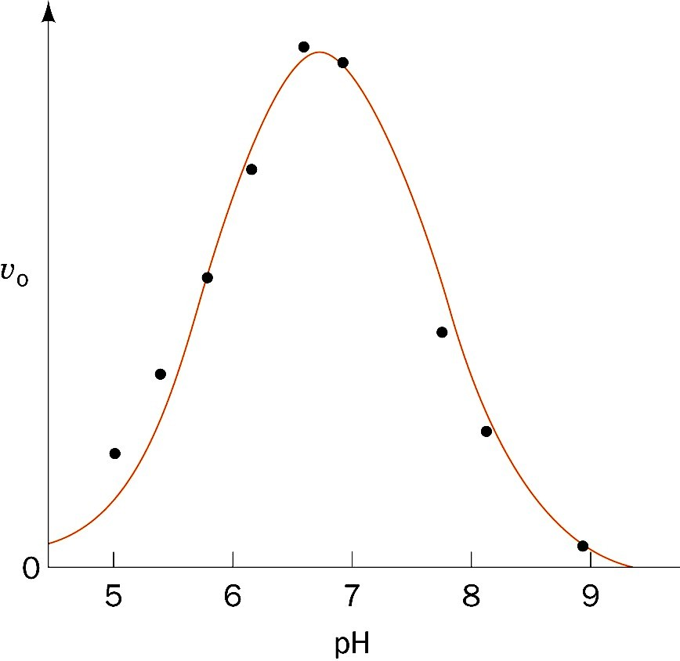
pH

Slide 26
Effects of pH on Enzyme Activity
Binding of substrate to enzyme
Ionization state of “catalytic” amino acid residue side chains
Ionization of substrate
Variation in protein structure

Slide 27
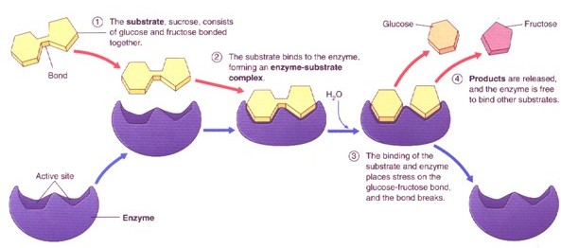
Induced Fit Model: the enzyme undergoes a conformational change upon initial association with the substrate and this leads to formation of the active site.

Slide 28

Zeolites - Shape-Selective Catalysis by Zeolites
Shape-selective catalysis are those reactions that depend on the pore structure of the catalyst and the size of the reactant and product molecules. In such reactions, zeolites are used as catalysts. Zeolites are microporous aluminosilicates of the general formula M_{x/n} [(AlO₂)_{x} (SiO₂)_{y}].z
H₂O where n is the charge of the metal cation, M^{n+}. M is usually Na⁺, K⁺ or Ca²⁺ and z is the number of moles of water of hydration, which is highly variable. The characteristic of zeolites is the openness of the
[(Al₂)O₂]_{n} framework. In this framework, some of the silicon atoms are replaced by aluminium atoms. Zeolites are found in nature and they are also synthesized for catalytic selectivity. Because of the three dimensional
cage like structure, zeolites can be used as ion-exchange materials and selective adsorbents.

Slide 29
What is ZSM-5 Catalyst ?
It is an abbreviation for (Zeolite Scony Mobile Number 5 )
First synthesized by Mobil Company in 1972
It replaces many Homogeneous Catalysts were many petrochemical processes
ZSM-5 has two diameters for its pores : d₁= 5.6 Å , d₂= 5.4 Å
➢Where as, Zeolite Y has a diameter = 7.4 Å
used in

Slide 30
Properties ZSM-5
The ZSM-5 zeolite catalyst is used in the petroleum industry for hydrocarbon interconversion.
ZSM-5 zeolite is a highly porous aluminosilicate with a high silica/alumina ratio.
•
•
•
•
It has an intersecting two-dimensional pore structure.
The aluminum sites are very acidic. The acidity of the zeolite is very high.
The reaction and catalysis chemistry of the ZSM-5 is due to this
acidity.

Slide 31
Classification of disperse systems
Dispersed phase
Gas Liquid Solid
Medium or Phase
Gas
Dispersion medium
None
Liquid aerosol
(fog, hair sprays)
Solid aerosol (smoke cloud, air particles)
(All gases are mutually
miscible)
Liquid
Foam (whipped cream,
Emulsion
(milk
Sol
(blood pigmented ink)
shaving cream) mayonnaise)
Solid
Solid foam Gel (aerogel, pumice polystyrene foam)
Solid sol
(agar, gelatine jelly, opal)
(jewel, gemstone)

Slide 32
Properties of disperse systems
Heterogenous dispersion
Colloid dispersion
True solution
Pass through membranes
Semipermeabil does not pass
−
+
Visibility of particles
Eye, optical microscope
Electron microscope
Ultracentrifu- gation
−
Sedimentation
+
−
Thermal motion
Small
Middle
High

Slide 33
Properties of disperse systems
Heterogenous dispersion
Colloid dispersion
True solution
Colligative properties
−
Small
High
Diffuse
−
Slow
Fast
Optical properties
Frequently opaque
Opalescent (Tyndall effect)
Membrane filters
Transparent
Separability
Paper filters
None

Slide 34
Property | True solution | Suspension | Colloidal solution
Nature | Homogeneous | Heterogeneous | Appears to be homogenous but actually heterogeneous
Particle size | < 10^{–9} Aº (1 nm) | > 1000 Aº (100 nm) | Between 10 Aº (1 nm) to 1000 Aº (100 nm)
Sedimentation | Do not settle | Settle on standing | Do not settle
Diffusion | Diffuse quickly | Unable to diffuse | Diffuse slowly
Visibility | Particles invisible | Particles visible by naked eye or under microscope | Particles scatter light and can be observed under ultramicroscope
Filterability | Pass easily through animal membrane and filter paper | Unable to pass through animal membrane or filter paper | Pass through filter paper but not through animal membrane
Appearance | Clear and transparent | Opaque | Translucent

Slide 35
Optical Properties (Tyndall Effect)
When a strong beam of light is passed through a colloidal solution, the path of the light becomes visible when viewed from a direction at right angle to that of the incident light. This occurs because the colloidal particles absorb light energy and then scatter it in all directions. The phenomenon of scattering of light by sol particles to form illuminated beam or cone is called Tyndall effect or Tyndall beam or Tyndall cone.

Slide 36
< 1 nm
> 100 nm
solutions
colloids
suspensions
transparent (clear)
molecular motion never settle
transparent with Tyndall effect
Brownian motion- colloidal particles moved by solvent
coagulation – can settle
translucent (cloudy)
movement by gravity

Slide 37
< 1 nm
> 100 nm
solutions
colloids
suspensions
Absorption of light Passage of light
Scattering in all directions
Scattering in beam

Slide 38
Heterogenous dispersion
•
Suspension - heterogeneous fluid containing solid particles that are sufficiently large for sedimentation.
Particle size is > 1 μm
Dispersion is made by mechanical agitation (sand in the water).
Aerosol - a suspension of liquid droplets or a suspension of fine solid particles in a gas.
– Example : smoke, air pollution, smog etc.
•
•
•

Slide 39
Heterogenous dispersion
Emulsion - a mixture of two or more immiscible liquids
one liquid (the dispersed phase) is dispersed in the other (the continuous phase).
Prepared by shaking – oil/water (milk), water/ oil (butter).
•
•
•

Slide 40
Classification of colloids
Classification is based on following criteria
Physical state of dispersed phase and dispersion medium.
Nature of interaction between dispersed phase
and dispersion medium.
Types of particles of the dispersed phase.

Slide 41
Dispersed phase | Dispersion medium | Type of colloid | Example
Solid | Solid | Solid sol | Some coloured glasses, and gem stones
Solid | Liquid | Sol | Paints, cell fluids
Solid | Gas | Aerosol | Smoke, dust
Liquid | Solid | Gel | Cheese butter, jellies
Liquid | Liquid | Emulsion | Milk, hair cream
Liquid | Gas | Aerosol | Fog, mist, cloud, insecticide sprays
Gas | Solid | Solid sol | Pumice stone, foam rubber
Gas | Liquid | Foam | Froth, whipped cream, soap-lather

Slide 42
Classification based on nature of interaction
Lyophobic colloids (solvent hating colloids )
When metals and their sulphides simply mixed with dispersion medium, they don’t form colloids.
need stabilizing to preserve them.
irreversible.
For example, colloidal solutions of gold,silver, Fe(OH)₃, As₂S₃, etc.
Lyophilic colloids ( solvent loving)
Directly formed by substances like gum, gelatine rubber etc. on mixing with a suitable liquid(the dispersion medium).
self-stabilizing
reversible sols
For example, gums, gelatin, starch, albumin in water.

Slide 43
Classification based on type of particles of the dispersed phase
Multimolecular colloids : Consists of aggregates of a large number of atoms or smaller molecules whose diameter is less than 1 nm
Macromolecular colloids: In these colloids, the molecules have sizes and dimensions comparable to colloidal particles. For example, proteins, starch, cellulose.

Slide 44
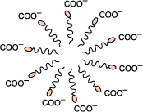
Associated colloids
At low concentrations, behave as normal, strong electrolytes .At higher concentrations exhibit colloidal state properties due to the formation of aggregated particles (micelles)
The formation of micelles takes place only above a particular temperature called Kraft temperature (T_{k}) and above a particular micelle concentration
Called Critical Micelle Concentration
E.g Soaps and detergents

Slide 45
Multimolecular colloids | Macromolecular colloids | Associated colloids
Formed by aggregation of large number of atoms or molecules with diameters less than 1 nm | Formed by large sized molecules | Formed by aggregation of large number of ions in concentrated solution
Lyophilic in nature | Lyophobic in nature | Both lyophilic and lyophobic in nature
Molecular mass is intermediate | High molecular mass | High molecular mass
Held by weak van der Waals’ forces | Held by stronger van der Waals’ forces due to the long chains | van der Waals’ forces increase with increase in concentration

Slide 46
Preparation of Lyophobic sols
Condensation methods
Particles of atomic or molecular size are induced to form aggregates
Oxidation method
Sulphur colloids are prepared by oxidation of H₂S by O₂.
Reduction
Silver colloids are prepared by passing H₂ through a saturated aqueous solution of silver
oxide at 65° C.
Hydrolysis
Dark brown Fe(OH)₃ colloidal solution is prepared by adding FeCl₃
into boiling water.
Double decomposition
Arsenious sulphide colloidal solution is prepared by passing of H₂S gas into a solution of As₂O₃.
Exchange of solvent
Colloidal solution of phosphorus is prepared by addition of alcohol nto a solution of phosphorous in excess water.

Slide 47
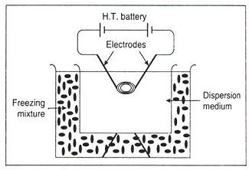
Preparation of Lyophobic sols
Dispersion methods
Mechanical disintegration
By vigorous mechanical agitation.
Peptization : Process of passing of a precipitate into colloidal particles on adding suitable electrolyte is known as peptisation
e.g. Fe(OH)₃ solution is formed from FeCl₃.
Electrol-disintegration (Bredig’s arc method)
Electrical disintegration of a colloidal solution, e.g. alternating
current passed through a gold solution.

Slide 48
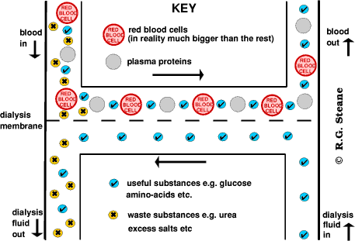
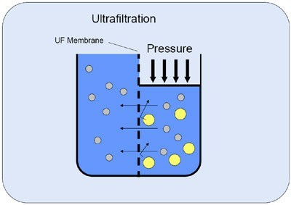
Purification of colloids
Dialysis
In this process, the colloidal particles are separated from the
impurities (mainly electrolytes) by the diffusion through a porous
membrane such as parchment, collodion, etc.
Electrodialysis
This is a special type of dialysis process, which is accelerated by the
application of a potential difference across the membrane. So ions
migrate faster than the colloids .
Ultrafiltration
In this process the colloidal particles are separated by the process of
filtration, through a filter paper, which is impregnated with gelatin or
collodion followed by hardening in formaldehyde.

Slide 49
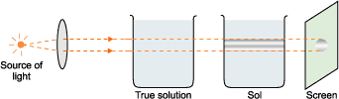
Properties of colloids
Optical properties: Tyndall effect
When a beam of light falls at right angles to the line of view through a solution, the solution appears to be luminescent and due to scattering of light the path becomes visible.
Quite strong in lyophobic colloids while in lyophilic colloids it is quite weak.

Slide 50

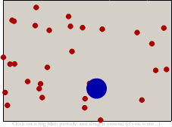
Properties of colloids
Brownian movement: Zig- zag movement of colloidal particles in a colloidal sol.
Brownian movement: Zig- zag
movement of colloidal particles in a colloidal sol.

Slide 51
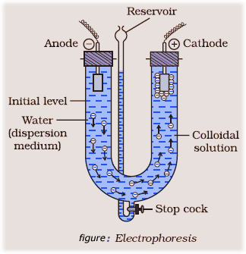
Electrical Properties (Electrophoresis)
Colloidal particles of a sol either carry positive or negative charge. The existence of charge on the colloidal particles can be demonstrated by a phenomenon called electrophoresis where the colloidal particles, when placed in an electric field, move towards either cathode or anode depending upon the charge on them.

Slide 52
Properties of colloids
Electro-osmosis: molecules of dispersion medium are allowed to move under influence of electric field
Coagulation or flocculation: Process which involves coming together of colloidal particles so as to change into large sized particles which ultimately settle as a precipitate or float on surface.It is generally brought about by addition of electrolytes. The minimum amount of an electrolyte that must be added to one litre of a colloidal solution so as to bring about complete coagulation or flocculation is called coagulation or flocculation value.Smaller is the flocculation value of an electrolyte , greater is the coagulating or precipitating power.

Slide 53
Properties of colloids
Hardy schulze law : Coagulating power of an electrolyte increases rapidly with the increase in the valency of cation or anion.
For negatively charged sol, the coagulating power of electrolytes are
AlCl₃ > BaCl₂ > NaCl or Al³⁺ > Ba²⁺ > Na⁺
For positively charged, then the coagulating power of electrolytes follow the following order:

Slide 54

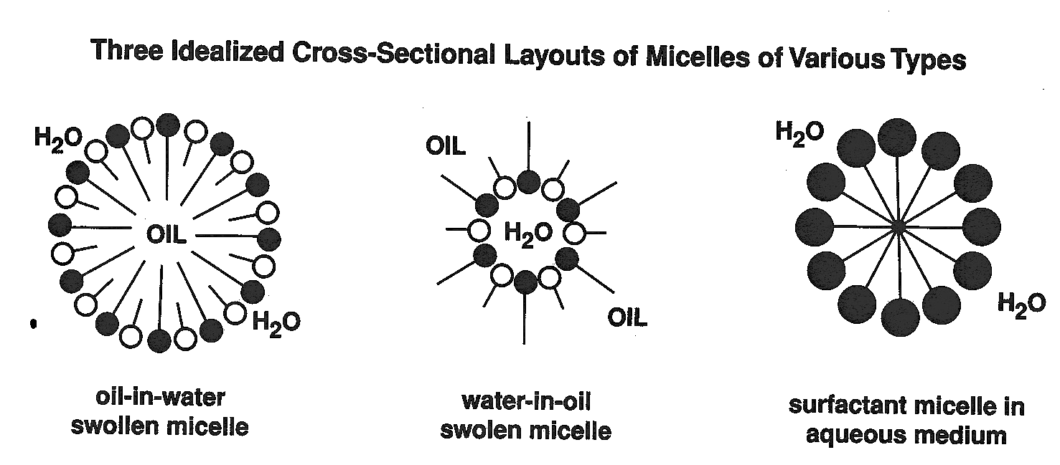
Micelles
If concentration is sufficiently high, surfactants can form aggregates in
aqueous solution ⇒ micelles.
Typically spheroidal particles of 2.5-6 nm diameter.
+
+
- ₋ ₋
+
McBain Lamellar Micelle
Hartley Spherical
Micelle
-
Water
-
-
Layer
+
-
-
+
Layer
Hydrocarbon
-
-
+
-
Water
Layer
⁻ - - ⁻⁻
+
+

Slide 55
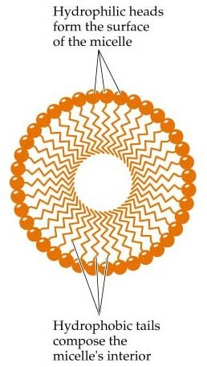
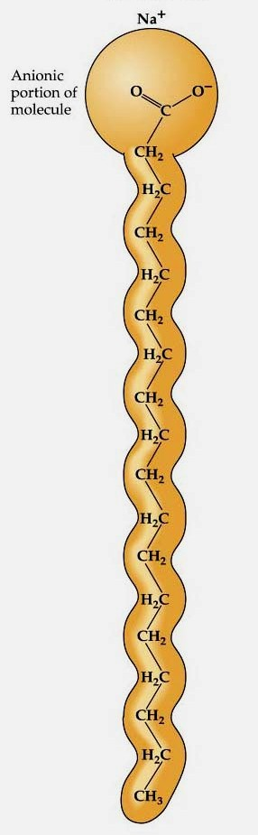
Soap Molecules
Hydrophilic ( lyophobic, water-loving) head containing a charged functional group
Hydrophobic ( lyophilic, water-fearing ) tail containing a hydrocarbon chain
If enough soap is added to water the molecules arrange themselves into a structure called a micelle

Slide 56

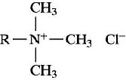

Types of Detergent Molecules
O
•
Anionic
^{S} O⁻Na⁺
O
Soap
Sodium dodecylsulfate (SDS)
+
N
•
Cationic
Br⁻
Cetylpyridinium bromide
O
•
Zwitterionic
O O
OCH₂CH₂N(CH₃)₃⁺
O
P _{O}-
O
Dipalmitoylphosphatidylcholine (lecithin)
•
Nonionic
O O
OH
O
O
Polyoxyethylene(4) lauryl ether (Brij 30)

Slide 57












Micellization Thermodynamics
Lyophobic (solvent-fearing) groups can perturb solvent structure and increase free energy of system. Surfactant will concentrate at the solvent- gas interface to lower ΔGº.
ΔGº can also be decreased by aggregation into micelles such that lyophobic groups are directed into interior of structure and lyophilic solvent-loving) groups face solvent.
Decrease in ΔGº for removal of lyophobic groups from solvent contact by micellization may be opposed by:
  loss in entropy &
  electrostatic repulsion for charged headgroups
Micellization is therefore a balance between various forces
AIR
WATER

Slide 58


















Micelles
--Temperature and Pressure--
T_{K}
surfactant crystals
Temperature
Surfactants much less effective below Krafft point, e.g. detergents.
For non-ionic surfactants, increase in temperature may result in clear solution turning cloudy due to phase separation. This critical temperature is the cloud point.
Cloud point transition is generally less sharp than that of Krafft point.

Slide 59
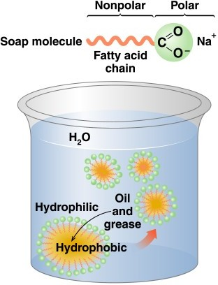
Cleaning Action of Soap
Soap contains a nonpolar carbon end that dissolves in nonpolar fats and oils, and a polar end that dissolves in water.
Dust and soap molecules form micelles that dissolve in water and are
washed away.
Soap forms a precipitate with ions in hard water (Ca²⁺, Mg²⁺, Fe³⁺)

Slide 60
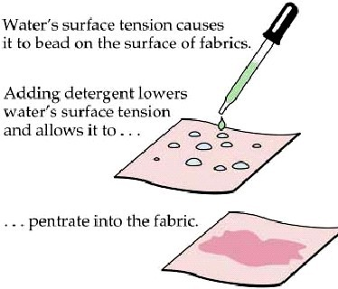
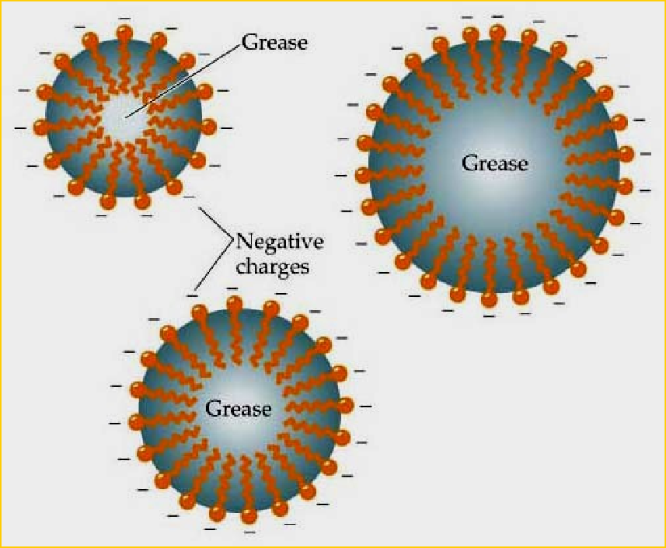
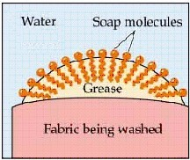
Soap: How does soap clean?
soap decreases surface tension of water, making it a better wetting agent.
soap converts greasy and oily dirt into micelles that become dispersed in water.
soap keeps the greasy micelles in suspension and prevents them from redepositing until they can be washed away. (repulsion of the charges)

Slide 61
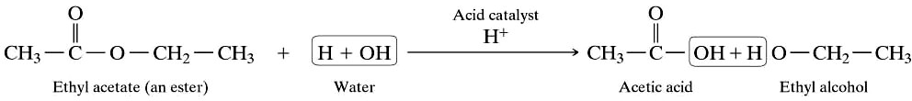
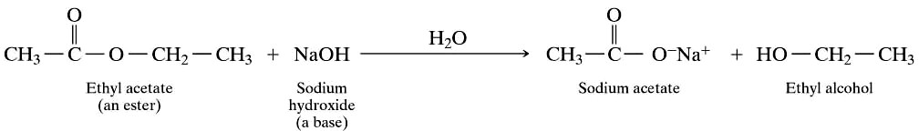
How are soap produced?
Through the breakdown of esters by a hydrolysis process.
This bond is broken
Acid-catalyzed and base-catalyzed hydrolysis.

Slide 62
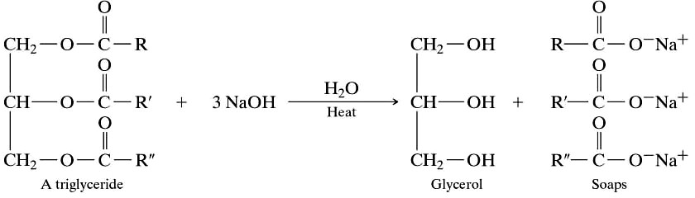
How are soap produced?
Soaps are not produced from simple esters such as methyl acetate but from more complex esters
animal fat
The saponification of a triglyceride.

Slide 63
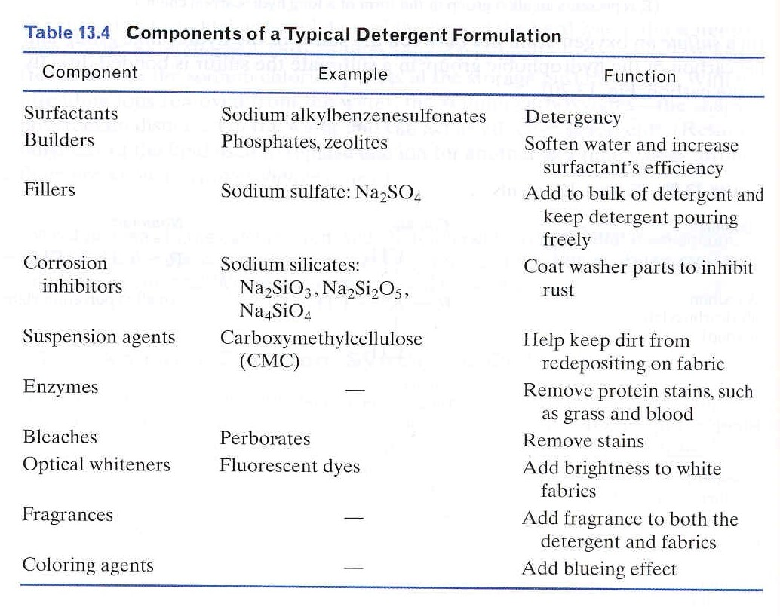
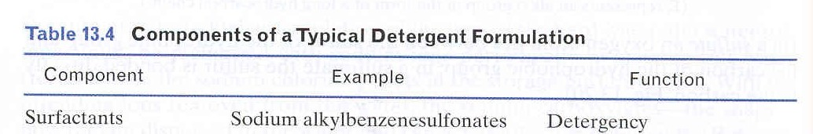
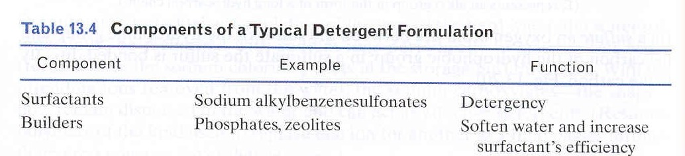
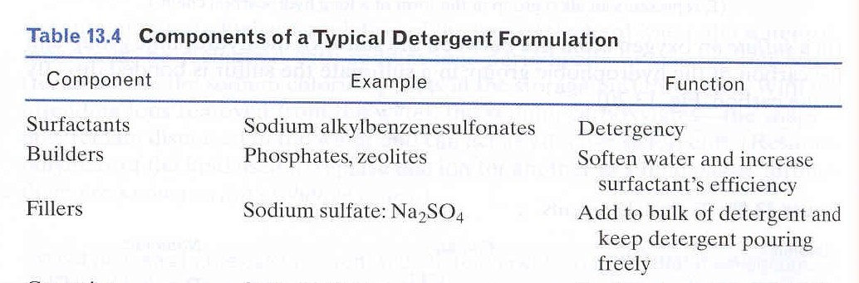
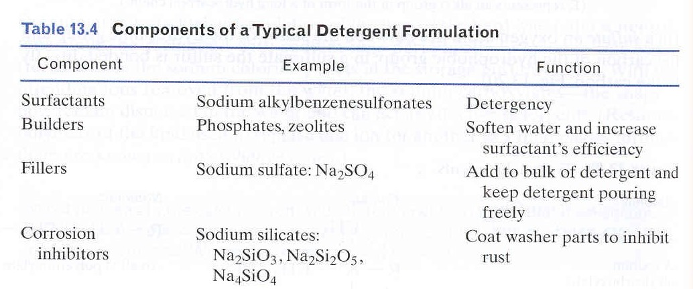
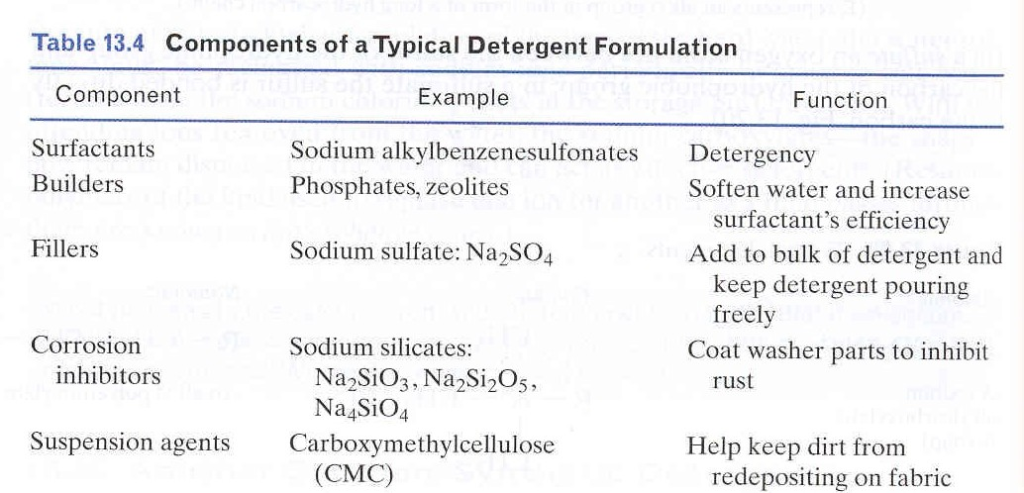
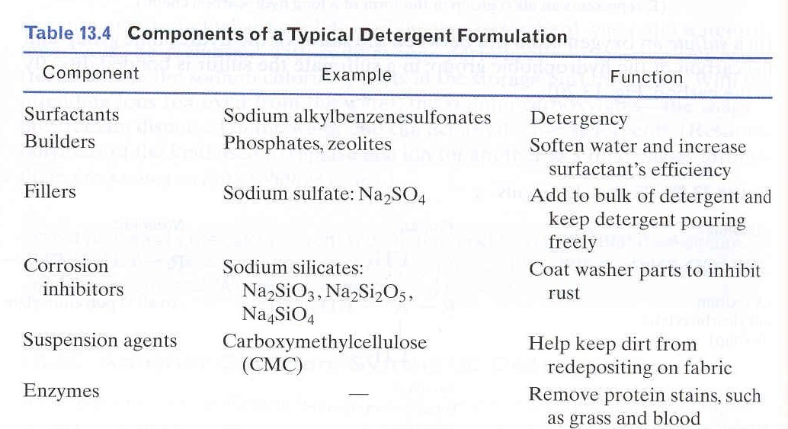
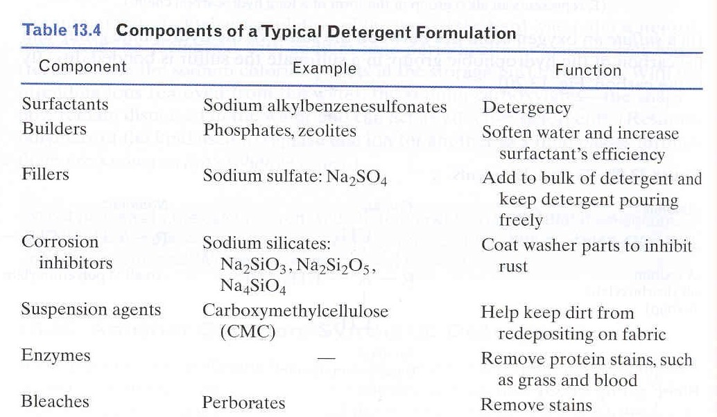
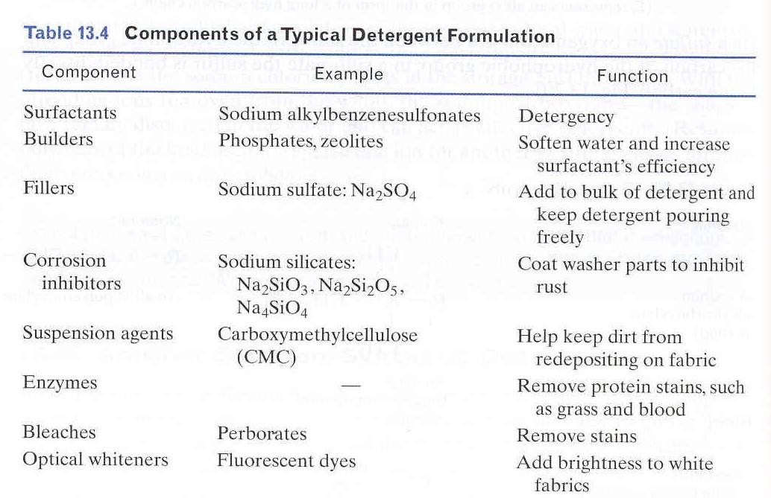
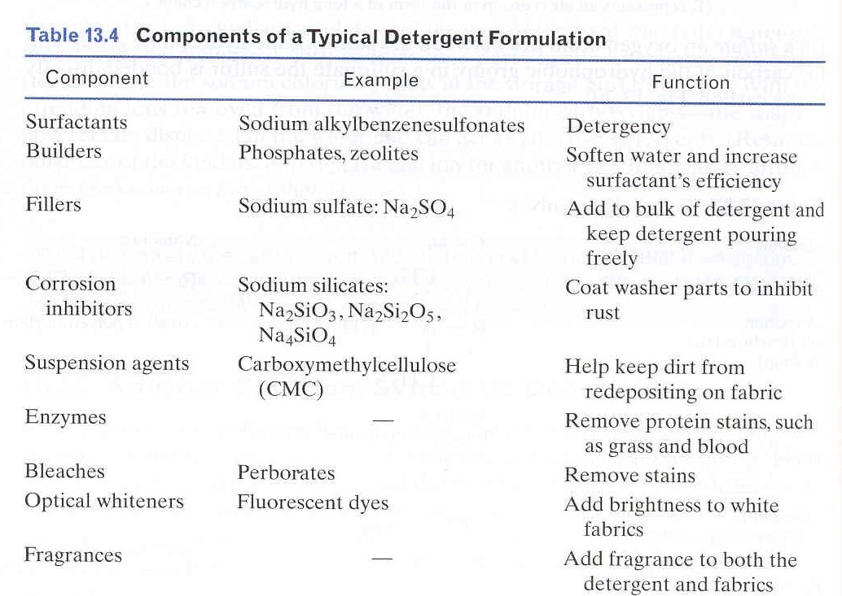

Slide 64
The rate of agglomeration of colloids depends on the net resultant force between colloids. The higher the net repulsive force the less effective will be the coagulation.
When colloids are subjected to an electrical field they will migrate generally toward the positive electrode of the field . They move because the inner part of the colloid (with higher charge density than the overall colloid) will respond to the field and leave the outer diffuse layer behind. The EDL actually shears at a plane and the potential (voltage) of the EDL at this shear plane is called the Zeta Potential, ζ.
The zeta potential represents the net charge between the primary charge and the counter charge in the EDL located between the surface and the shear plane. It’s with this charge that the colloid interacts with other colloids.

Slide 65
Removal of Hydrophobic Colloids from the Aqueous Phase
Removal of hydrophobic colloids in water and wastewater treatment processes involves two steps:
Destabilization (or Coagulation) - reduce the forces acting to keep the particles apart after they contact each other (i.e., lower repulsion forces).
Flocculation – process of bringing destabilized colloidal particles together to allow them to aggregate to a size where they will settle by gravity.
After coagulation /flocculation, gravity sedimentation, and sometimes filtration, are employed to remove the flocculated colloids.

Slide 66

EMULSIONS
Emulsions are colloidal solutions in which both the dispersed phase and dispersion medium are liquids.
Emulsions are broadly classified into two types.
Oil-in-water emulsion
Water-in-oil emulsion

Slide 67
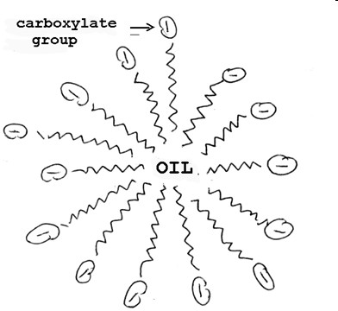

Emulsions
•
•
•
Miscible liquid form a solution
Lyophobic colloids form an emulsion
Emulsifying agent – substance require to form a stable emulsion
Emulsifyin agent is surface-active, i.e.it reduce the surface tension (soap, many other detergents.
•

Slide 68
Types of Emulsion
μm
Water
Oil
Oil-in-water emulsion
Water-in-oil emulsion

Slide 69

Preparation of emulsions
Emulsification
Emulsification is the process of making emulsions.
Emulsions are made by shaking the dispersed phase and dispersion medium vigorously and then stabilizing the emulsion with an emulsifier. Most often soaps and detergents are added to stabilize emulsions. Stabilization is obtained by the coating of the drops of an emulsion by the stabilizer. This prevents the drops of the emulsion from combining together and separating out as a separate layer. Other common stabilizing agents are proteins, gum and agar

Slide 70
Emulsion Type and Means of Detection:
Tests for Emulsion Type (W/O or O/W emulsions)
1) Dilution Test:
o/w emulsion can be diluted with water.
w/o emulsion can be diluted with oil.
2) Conductivity Test:
Continuous phase water > Continuous phase oil.

Slide 71
Applications of colloids
Rubber plating
Sewage disposal
Smoke screen
Purification of water
Cleaning action of soap
In medicine
Formation of delta
Photography
Artificial rain

Slide 72
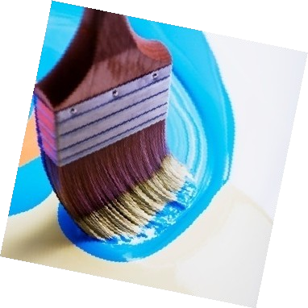


Applications of colloids
Colloids have uses in our daily life as well as in various industrial processes. Some of the applications where colloids are present are listed below.
Pharmaceutical industry makes use of colloidal solution preparation in many medicines. A wide variety of medicines are emulsions. An example is Cod Liver Oil
Paint industry also uses colloids in the preparation of paints.

Slide 73








